Slide 1
Surrogate Robot Body V1: Immersive Telepresence System
Project Demo
Prakash Waghela

Slide 2
Background
Telepresence
Tele – long distance
Presence – projection of self
Input the user gives to the system
Ability for user to interact with some environment via the system
Feedback the user receives from the system
Ability for user to gather data about some environment via the system

Slide 3
Project Aims
The primary aim of this project was to create some system which can be utilised to achieve some form of telepresence.
Secondary aims included:
Structuring the project in a way that allows for continuation.
Gaining more knowledge/experience in robotics and virtual reality/gesture capture.

Slide 4
Project Objectives
In order to achieve the project aim, I created the following objectives:
Review the available input hardware;
Leap Motion,
Myo Armband
Oculus Rift DK2
Review the available output hardware;
Oculus Rift DK2
Nao Robot
Design and implement some control scheme
Design and implement some feedback scheme

Slide 5
Project Plan
Review the available input hardware;
Leap Motion,
Myo Armband
Oculus Rift DK2
Review the available output hardware;
Oculus Rift DK2
Nao Robot
Design and implement some control scheme
Design and implement some feedback scheme
Phase 1 – Input Devices
Phase 2 – Output Devices
Phase 3 – Project Deliverable

Slide 6
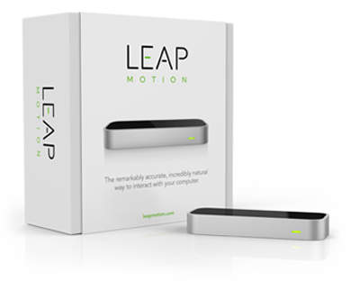
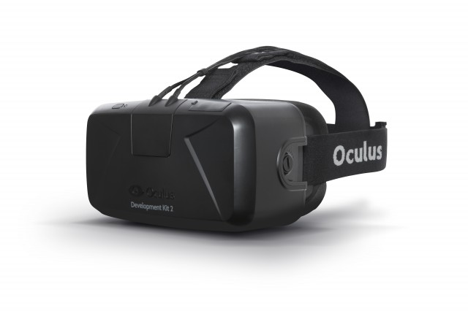
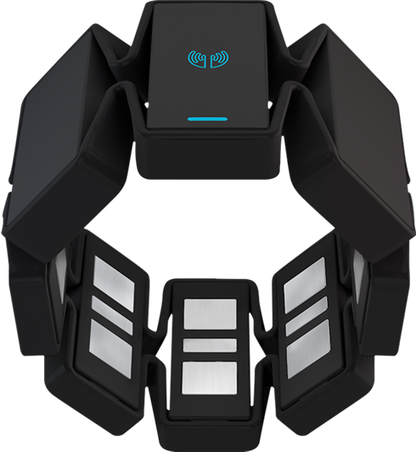
Phase 1 – Input Devices
Availability of data
Availability of documentation and support
Reliability of data
Ease of use and drawbacks
Figure 1 - A Myo Armband
(Thalmic Labs, 2016)
Figure 2 - A Leap Motion Device
(Leap Motion Inc, 2015)
Figure 3 - An Oculus Rift DK2
(Hutchinson, 2014)

Slide 7
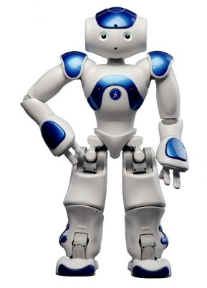
Phase 2 – Output Devices
Format of required data
Availability of documentation and support
Quality of feedback
Ease of use and drawbacks
Figure 3 - An Oculus Rift DK2
(Hutchinson, 2014)
Figure 4 - The Nao Robot
(Aldebaran - Softbank Robotics, 2014)

Slide 8
Phase 3 – Project Deliverable

